Slide 1
College of General Studies, Online Learning
Record, Edit, Engage: Building Better Video Lectures with Panopto
Facilitator: Jim Reed
Wednesday, November 19, 2025 at 1:00 PM

Slide 2

Agenda
Let’s watch: Panopto in action
Let’s record: Creating your sample video
Post-production techniques
Debrief
Closing
CGS, Online Learning, 2025

Slide 3

Session Goals
Analyze an exemplar mini-lecture to collaboratively determine best practices
Create videos using Panopto in your sample course
Employ four engaging post-production techniques using Panopto
CGS, Online Learning, 2025

Slide 4

You will not walk away from this session with…
A budding career as a film editor
Expertise in advanced editing software
The ability to write a white paper on the pedagogical underpinnings of effective online mini-lectures
CGS, Online Learning, 2025

Slide 5
College of General Studies, Online Learning
Analyzing an Exemplar

Slide 6
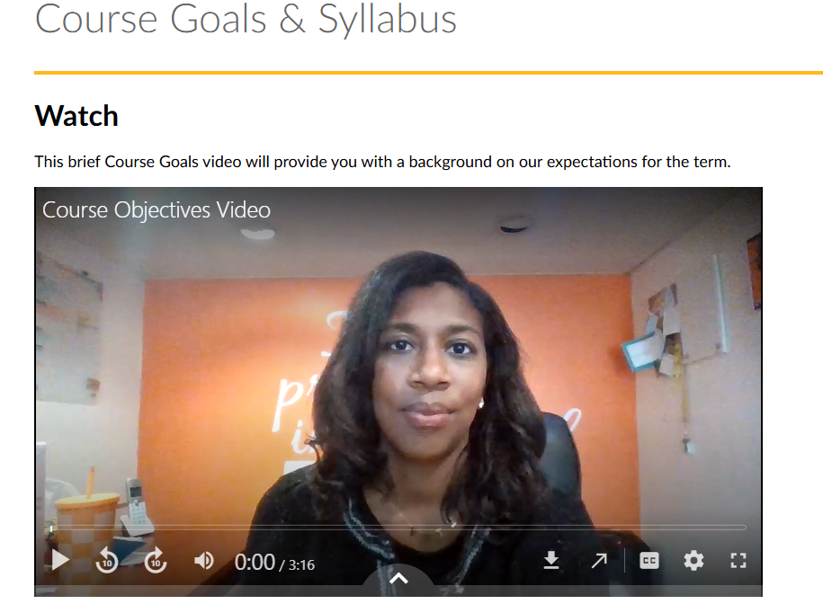
Let’s watch an example…
As you watch, consider:
What stands out as particularly effective, and why?
What is one thing you see here that could level up your mini-lectures?
CGS, Online Learning, 2025

Slide 7
Screenshare Place Holder ☺
CGS, Online Learning, 2025

Slide 8

Now, let’s discuss…
What stands out as particularly effective, and why?
What is one thing you see here that could level up your mini-lectures?
CGS, Online Learning, 2025

Slide 9
A great mini-lecture…
Looks and feels professional
Is short, well-rehearsed and focused
Is accessible to all students
Engages students at least once
CGS, Online Learning, 2025

Slide 10
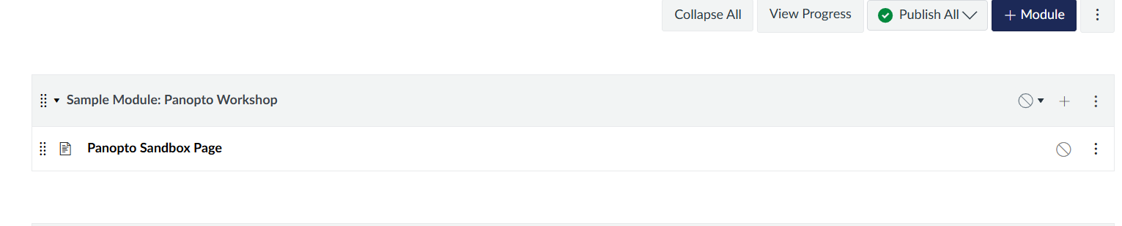
Let’s Prepare!
Navigate to your Dev Shell and find the “Sample Module: Panopto Workshop” Module
Locate the attached assets in my Email from 11/17
Save those somewhere
CGS, Online Learning, 2025

Slide 11
College of General Studies, Online Learning
Part 1: Recording your Video

Slide 12

Part 1, Step 1: How to Record Your Video
Watch “Recording Your Video” on the next slide
As you watch, note:
What do you notice?
What questions do you have?
CGS, Online Learning, 2025

Slide 13
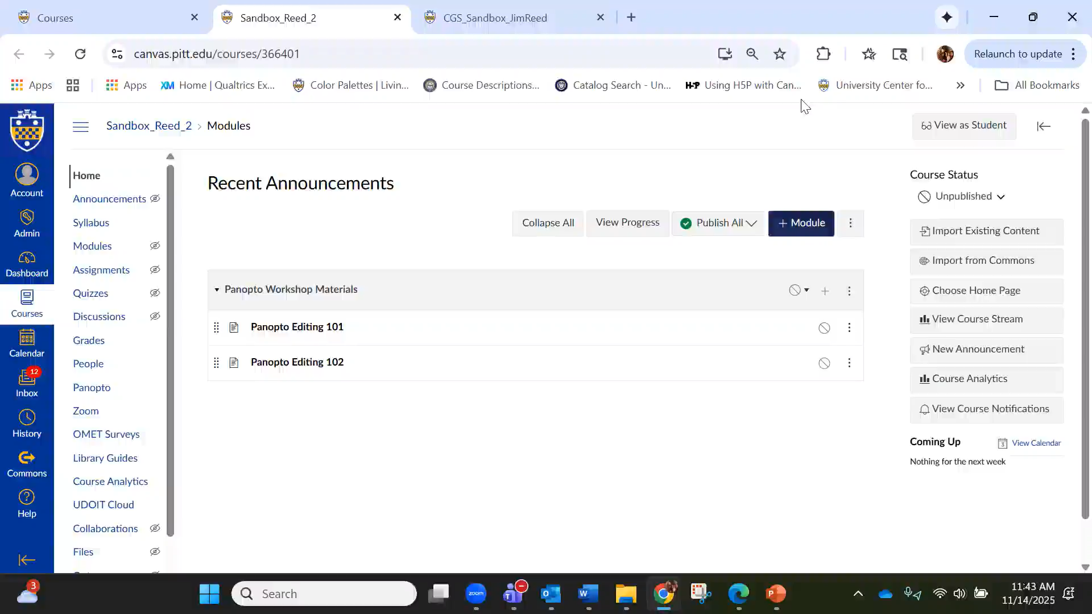
Part 1, Step 1: How to Record Your Video
CGS, Online Learning, 2025

Slide 14

Part 1, Step 2: Record Your Video
Now, create your 2-minute video!
As you work, please feel free to use the video to guide your production
CGS, Online Learning, 2025

Slide 15
College of General Studies, Online Learning
Part 2: Adding Captions

Slide 16
Part 2, Step 1: How to Add Captions
Watch “Adding Closed Captions” on the next slide
As you watch the video, consider:
What do you notice?
What questions do you have?
CGS, Online Learning, 2025

Slide 17
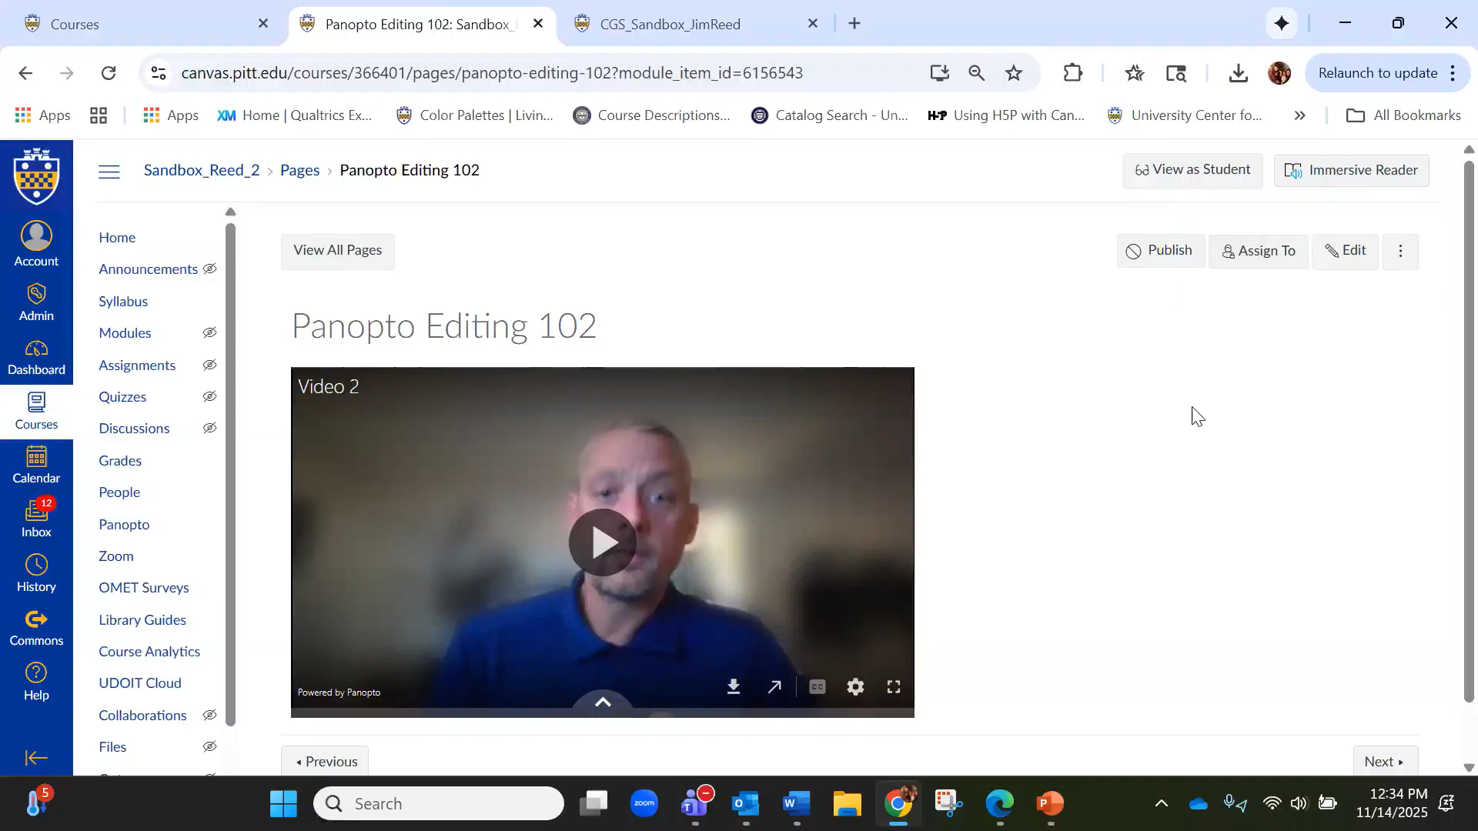
Part 2, Step 1: How to Add Captions
CGS, Online Learning, 2025

Slide 18

Part 2, Step 2: Add Your Captions
Now, add and revise your closed captions!
As you work, please feel free to use the video to guide your production
CGS, Online Learning, 2025

Slide 19
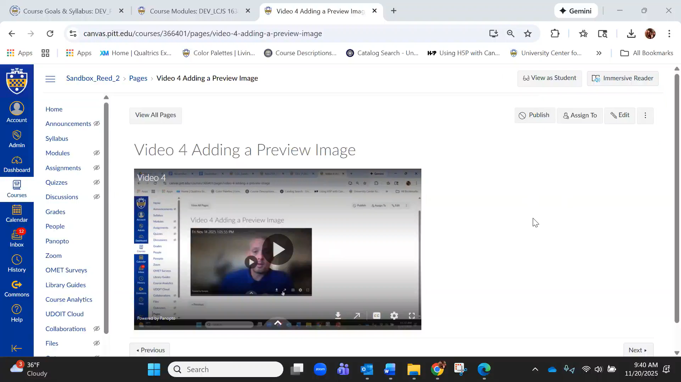
Part 2, Step 3: How to Download Captions
CGS, Online Learning, 2025

Slide 20
College of General Studies, Online Learning
Part 3: Trimming your Video

Slide 21
Part 3, Step 1: How to Trim your Video
Watch “Trimming Your Video”
As you watch, consider:
What do you notice?
What questions do you have?
CGS, Online Learning, 2025

Slide 22
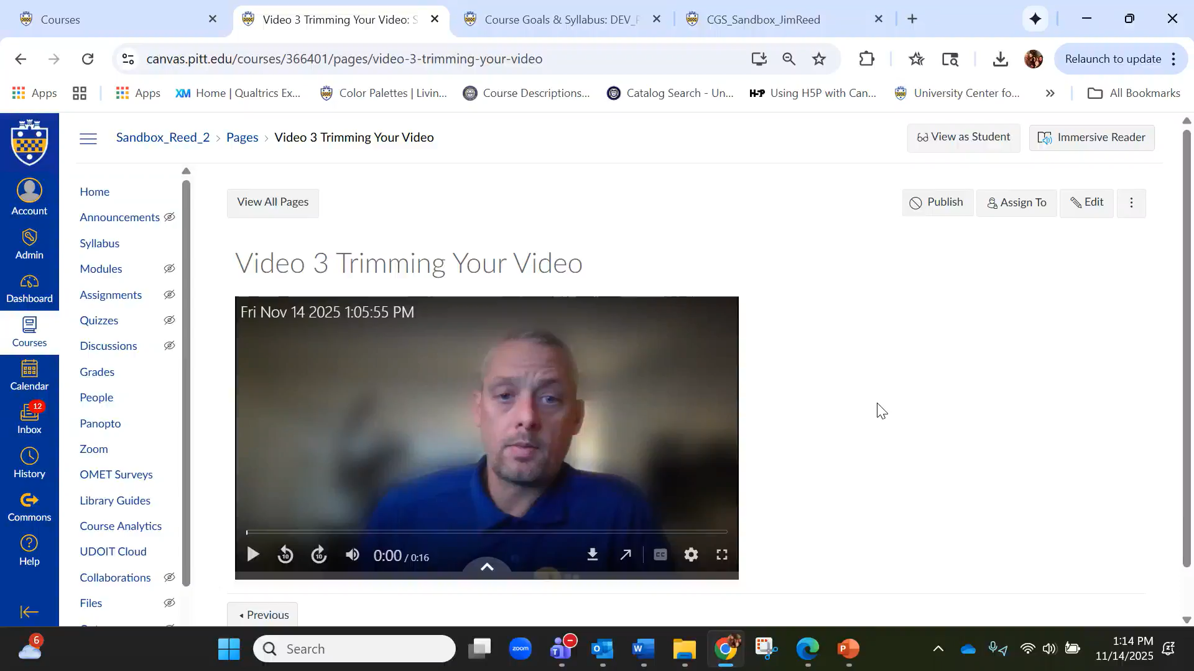
Part 3, Step 1: How to Trim your Video
CGS, Online Learning, 2025

Slide 23

Part 3, Step 2: Trim Your Video
Trim your own video!
As you work, feel free to refer to the previous video for guidance
CGS, Online Learning, 2025

Slide 24
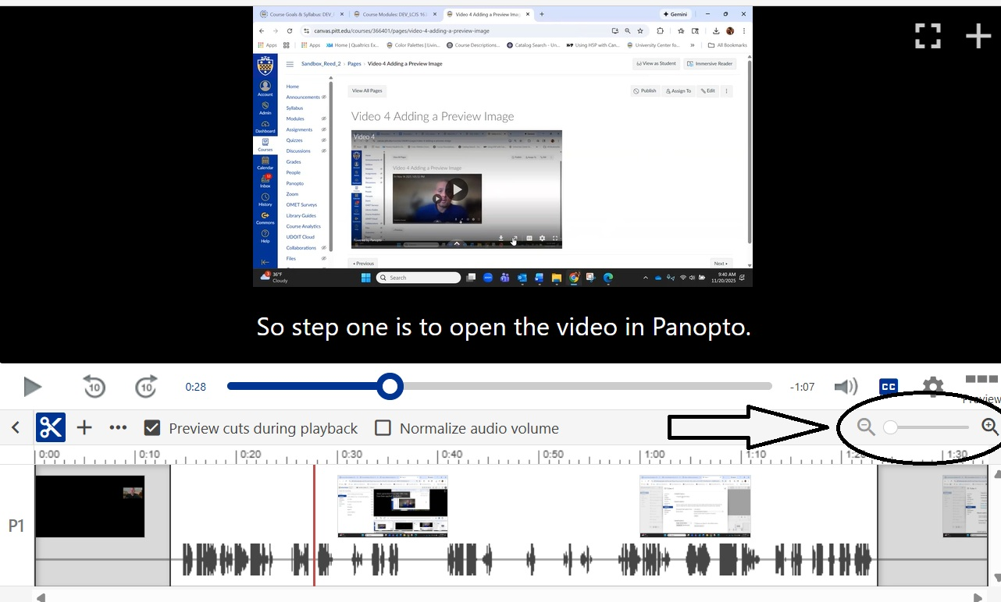
Part 3, Step 3: Zooming the Editor
Finding the precise moment in a video to begin your editing can be tricky. Two tips to help combat this are:
Make a defined pause at a mistake so it’s easy to find in the editor
Zoom in on the linear editor by using the magnify option shared in the image to the right.
CGS, Online Learning, 2025

Slide 25
College of General Studies, Online Learning
Part 4: Adding A Preview Image

Slide 26
Part 4, Step 1: How to Add a Preview Image
Watch “Adding a Preview Image”
As you watch, consider:
What do you notice?
What questions do you have?
CGS, Online Learning, 2025

Slide 27
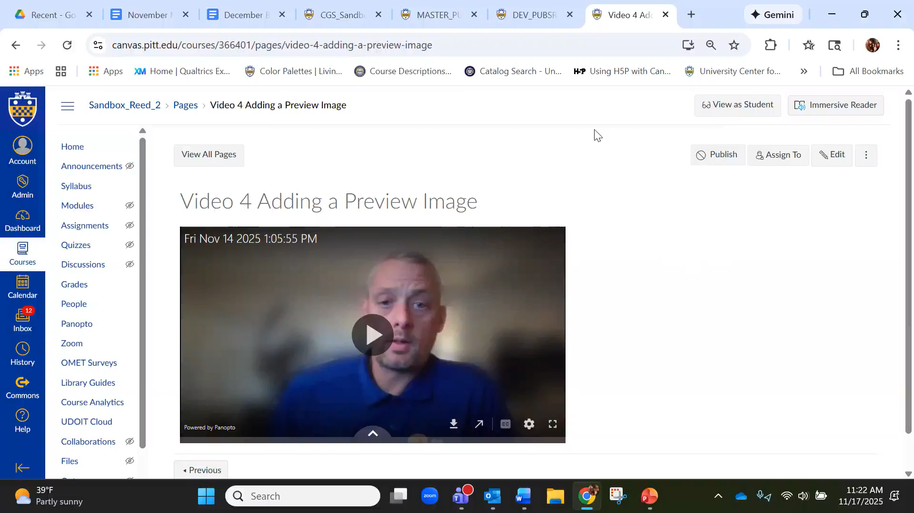
Part 4, Step 1: How to Add a Preview Image
CGS, Online Learning, 2025

Slide 28

Part 4, Step 2: Add your Preview Image
To add a preview image, the first thing you will need is an appropriate image saved on your computer. After that, it’s almost as easy as sending an email attachment!
CGS, Online Learning, 2025

Slide 29
College of General Studies, Online Learning
Part 5: Embedding Engagement Questions

Slide 30
Part 5, Step 1: How to Embed Engagement Questions
Watch “Adding Questions” on the next slide
As you watch, consider:
What do you notice?
What questions do you have?
CGS, Online Learning, 2025

Slide 31
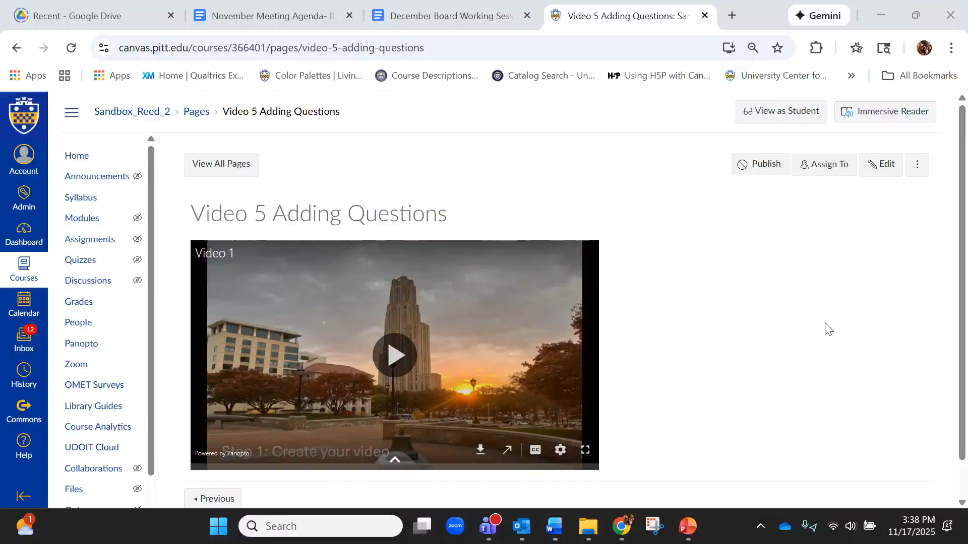
Part 5, Step 1: How to Embed Engagement Questions
CGS Online Learning, 2025

Slide 32

Part 5, Step 2: Add Engagement Questions
Add an engagement question to your video!
As you work, feel free to turn off your camera
If you have questions, put them in the chat
CGS, Online Learning, 2025

Slide 33

College of General Studies, Online Learning
Debrief and Next Steps

Slide 34
Let’s Debrief!
What is one tool that you’ve added or sharpened in this session?
What questions do you have?
CGS, Online Learning, 2025

Slide 35
Remember: A great mini-lecture…
Looks and feels professional
Is short, well-rehearsed and focused
Is accessible to all students
Engages students at least once
Thanks, Marita!
CGS, Online Learning, 2025

Slide 36


Thank you
from the CGS Online Learning Team

Slide 37
Supplemental Resources
Pitt Branding Site (for Licensed Preview Images)
CGS, Online Learning, 2025

